Slide 1

Forestview Technologies Project 1: Detroit Tigers Wholesale Application
Talha Ali, Mohammad Hoque, Soham Bhavsar, Maher Harkati, Amran Rahim

Slide 2
Introduction
The goal of this project was to allow end users to have quick and easy access to storing, removing, and adding a product to inventory.
Clients should have ease of access for all these operations and not worry about the behind the scenes.
This project allows users to manipulate a CSV file by the operations stated before efficiently and quickly.

Slide 3
Project Overview
Front End:
Website: Users get an introduction to the team behind Forestview as well as information about the company's purpose. The projects tab holds our current and future projects and upon downloading the project they are prompted to accept terms and condition as well as technical compliance!
Back End:
GUI: Users/Clients are given fields for adding a product to inventory(.csv file), searching to see if their product is in inventory, as well as removing their inventory is they so please.

Slide 4
Tech Stack
Version Control & Collaboration:
GitHub Desktop was the main source of collaboration as different forks were created for the different tasks divided amongst team members. Visual Studio Code was the IDE used by the team for consistency and ease of use.
Front End:
HTML, CSS, and JavaScript
Back End:
Python – Tkinter & CSV

Slide 5
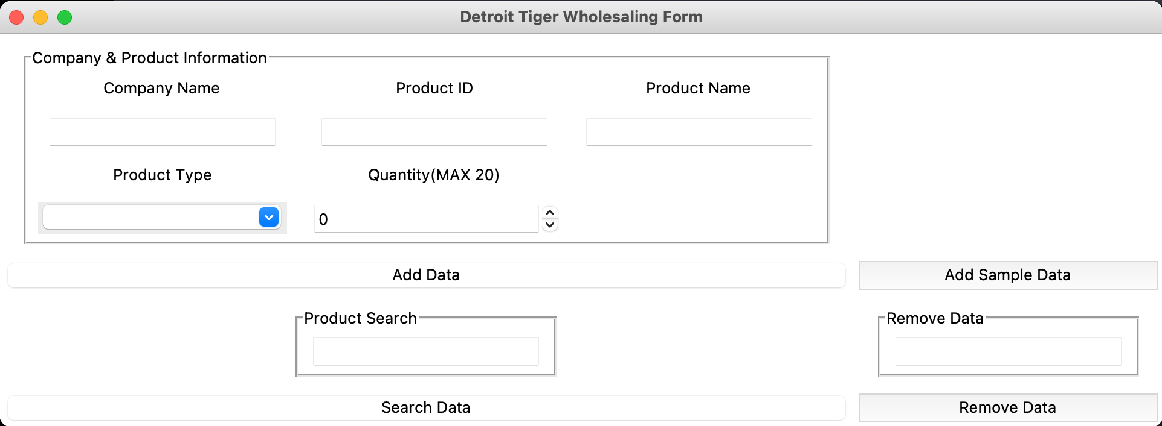
Project Demo

Slide 6
Challenges Along The Way
Front End: The sizing for the images for meet the team section was always off and had to keep readjusting and adding CSS features of the layout. Also, the implementation to the JavaScript for the user to check the box to continue for the download was not hard but learning the syntax is different
Back End: The sizing of the button frames in the GUI gave us difficulty as we could not figure out how to get them to be next to each other and sized right. In the end we figured out how to get them next to each other, but couldn’t fix the sizing error in time. The error boxes was also hard to have pop up but once we figured out how to display them it was smooth sailing.

Slide 7

Conclusion
In conclusion our team worked together effectively and efficiently, fulfilling all the tasks provided to use toward the project! The collaboration of the team and assignment of duties created an easy path to the finish line.

